Slide 1
Introduction to
Scouts BSA
Troop (num) (Town) CT
(Month) 2023

Slide 2
What do we do in
Scouts BSA?
Job one is have fun

Slide 3
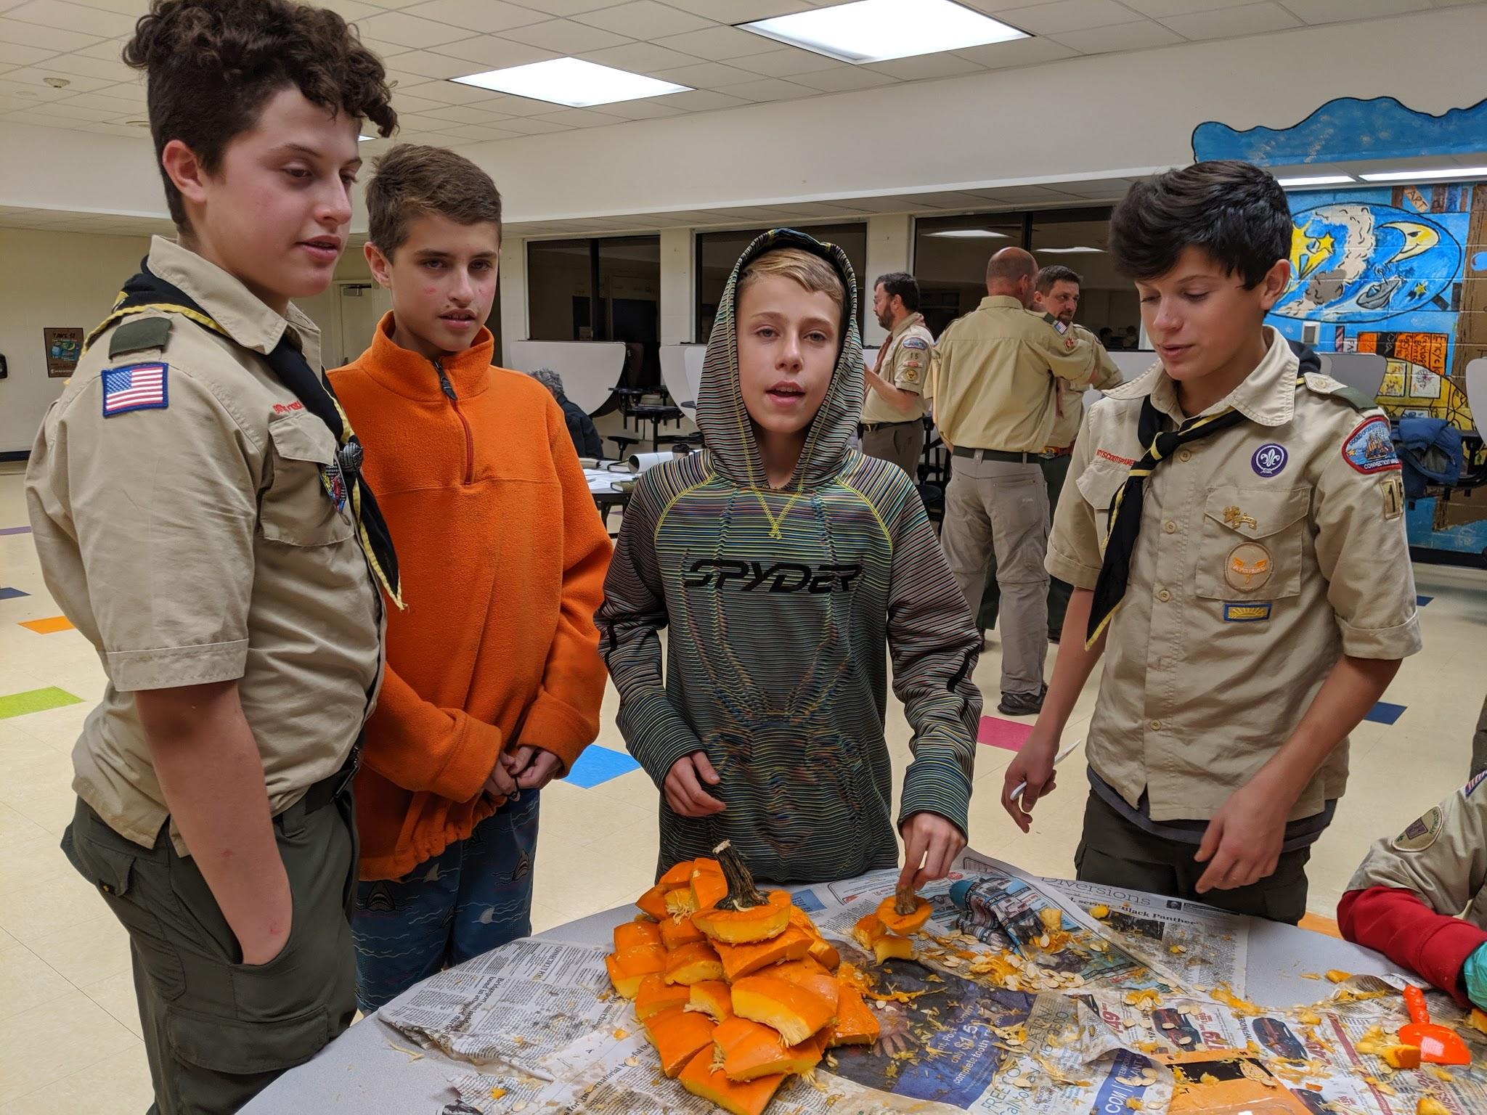
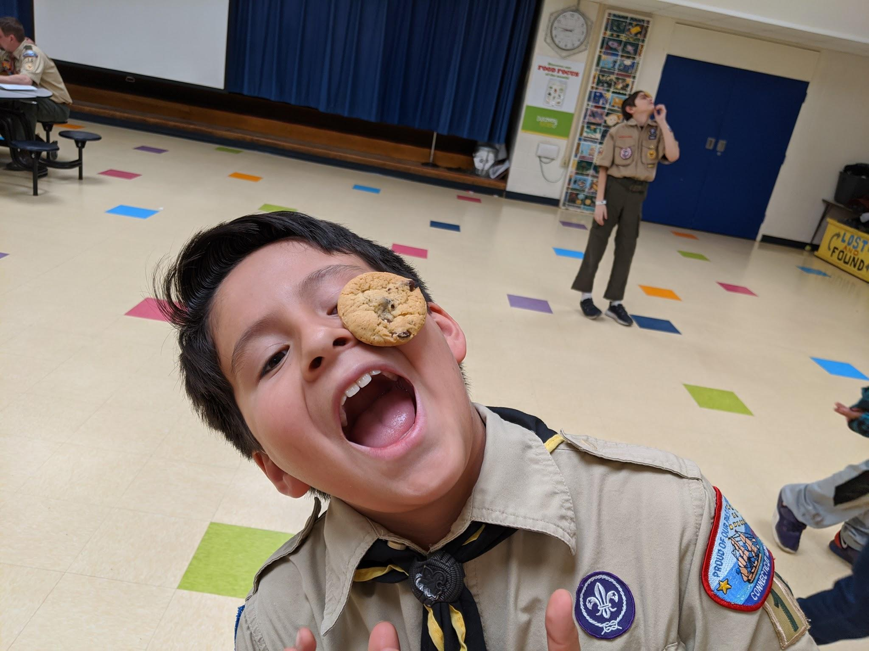
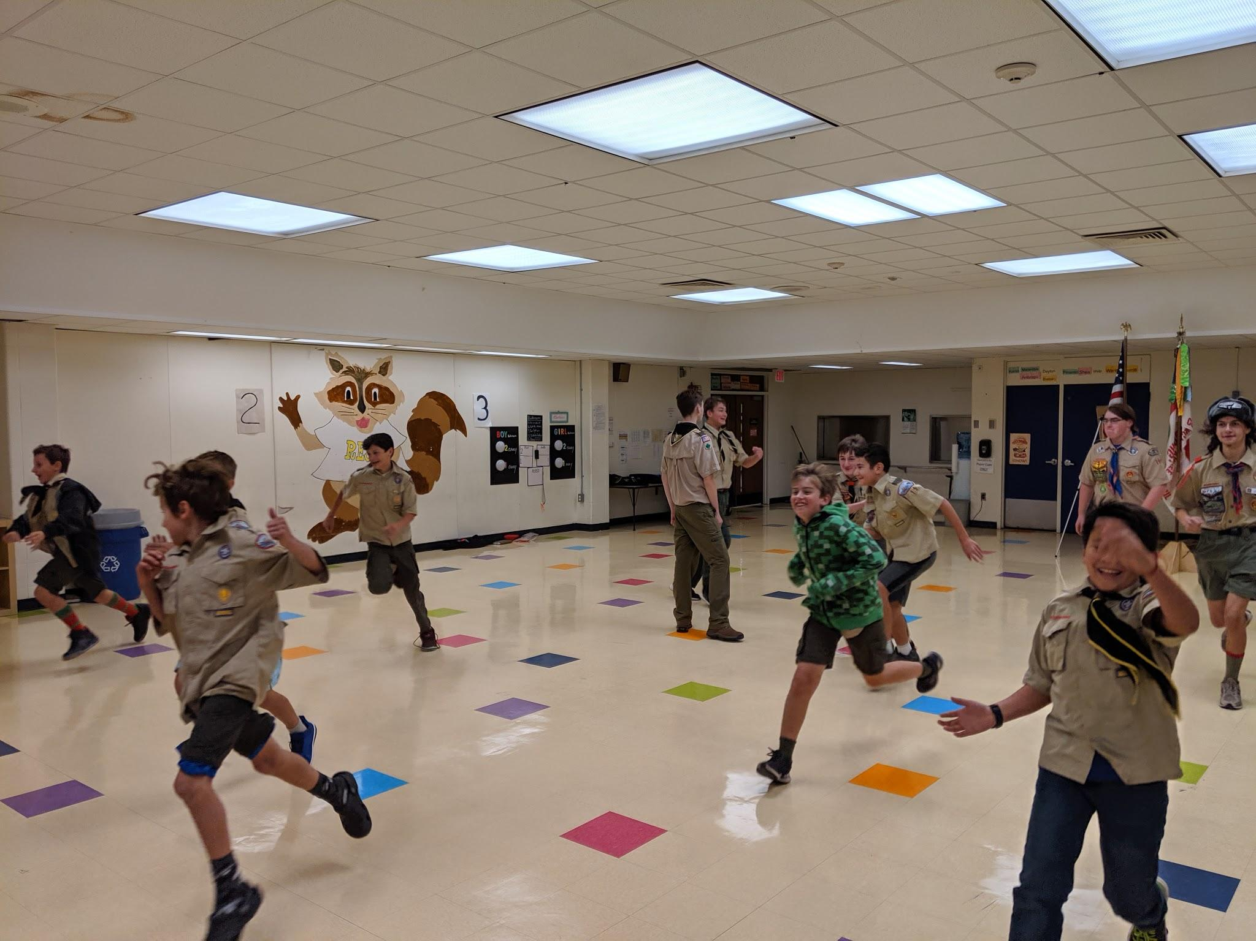
Troop Meetings
Fun! Fun! Fun!
Training
Advancement
Games
Challenges
3x per month during
school year

Slide 4
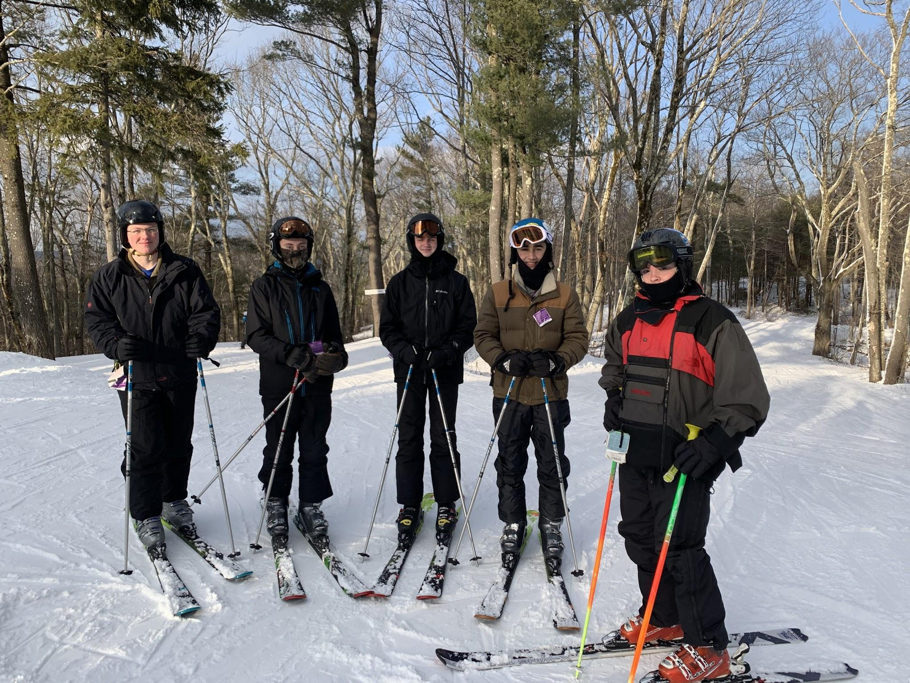
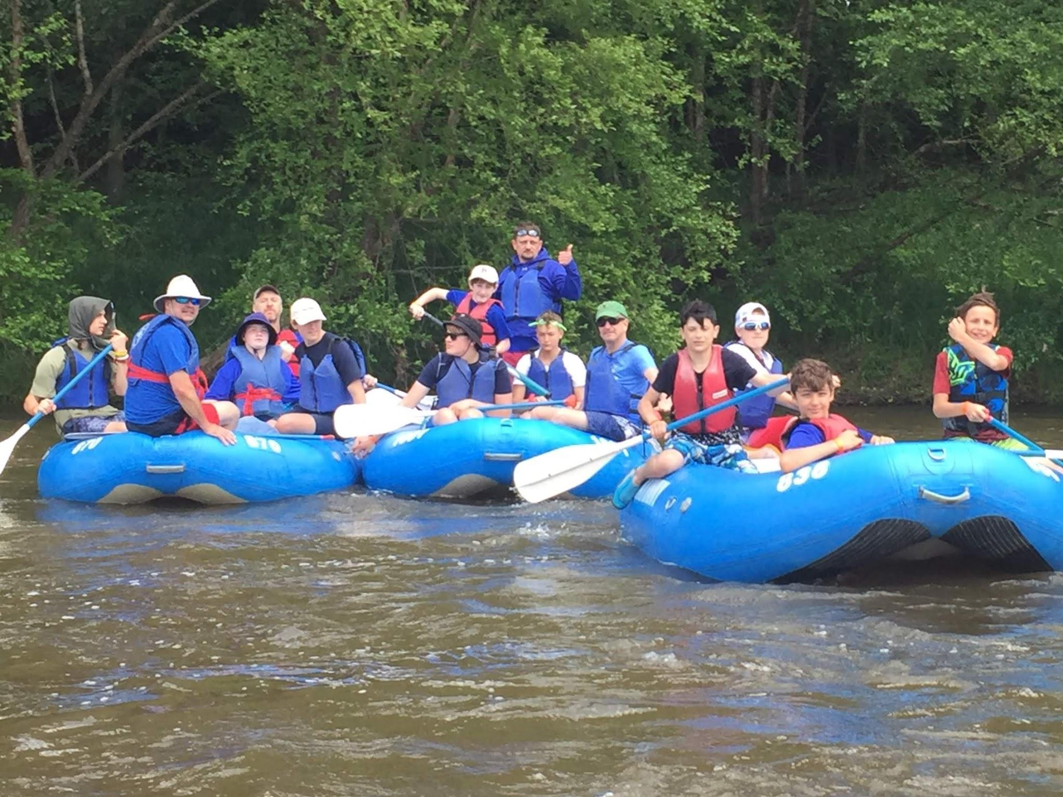
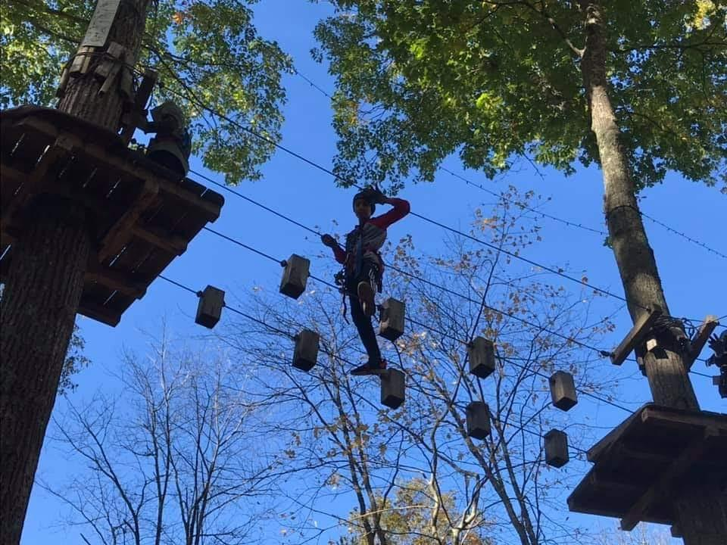
Campouts
Tent camping, lean-tos, backpacking
Skiing, canoeing, rock-climbing
Fire
Knives
All the good stuff…
1x per month
One big campout
per year in June

Slide 5
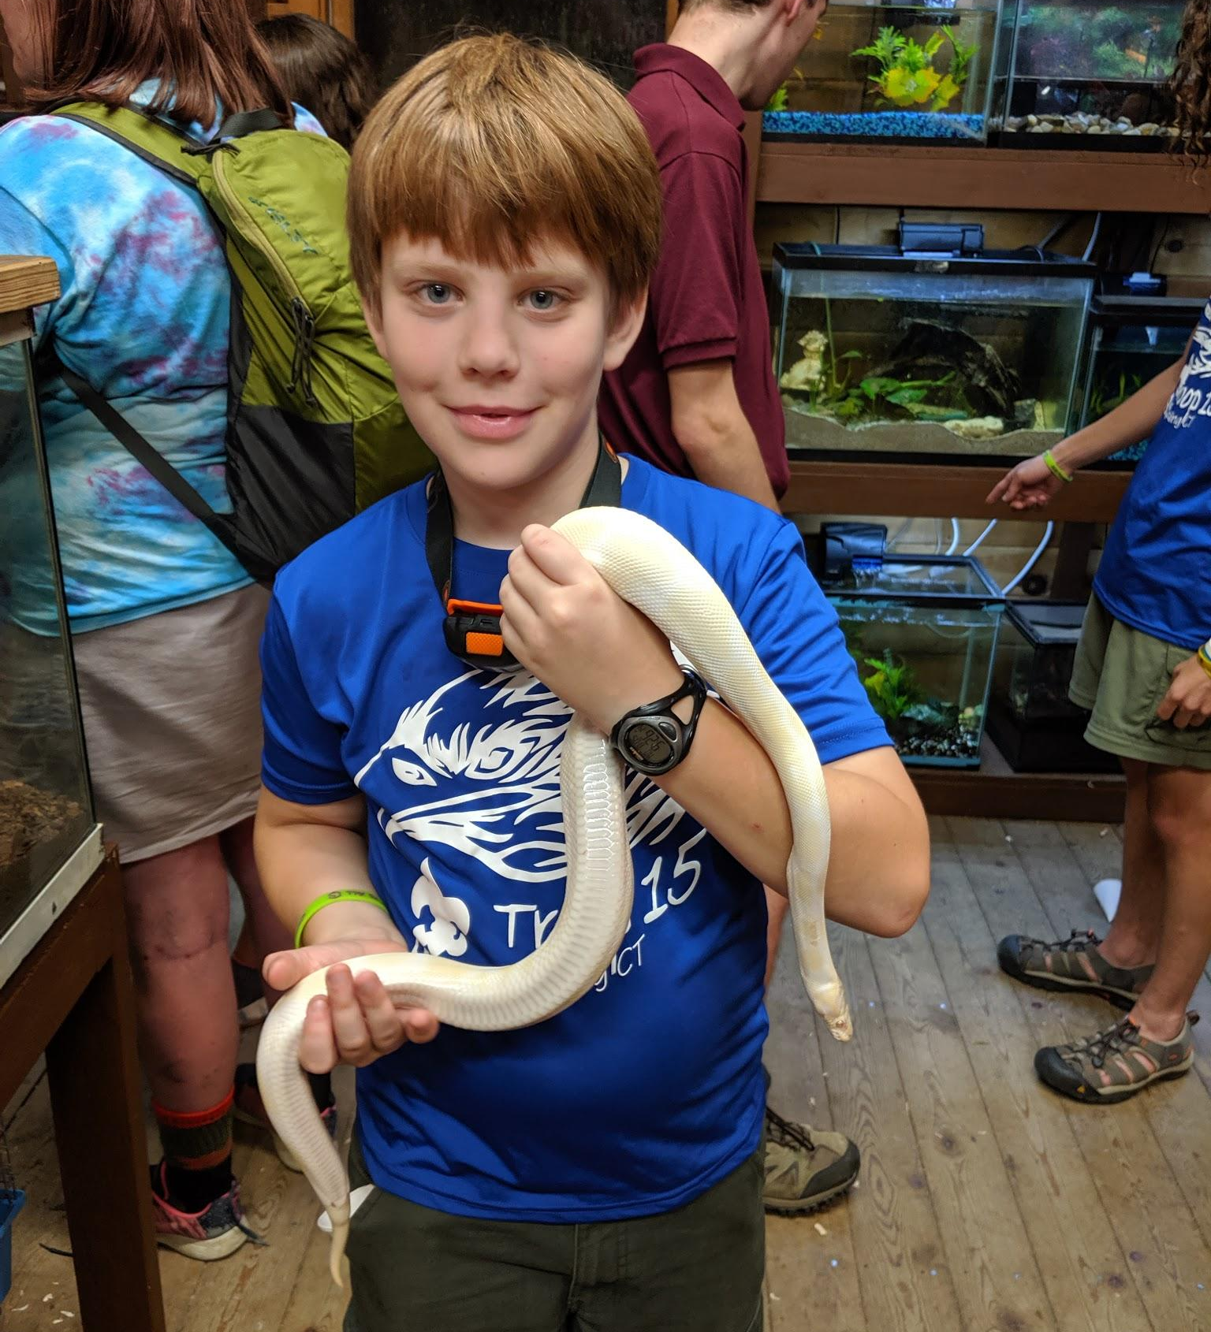
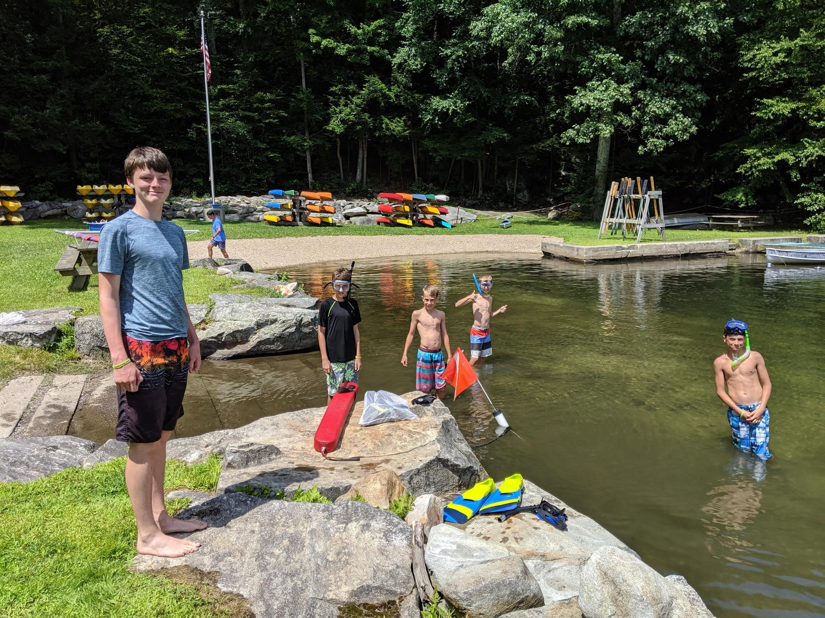
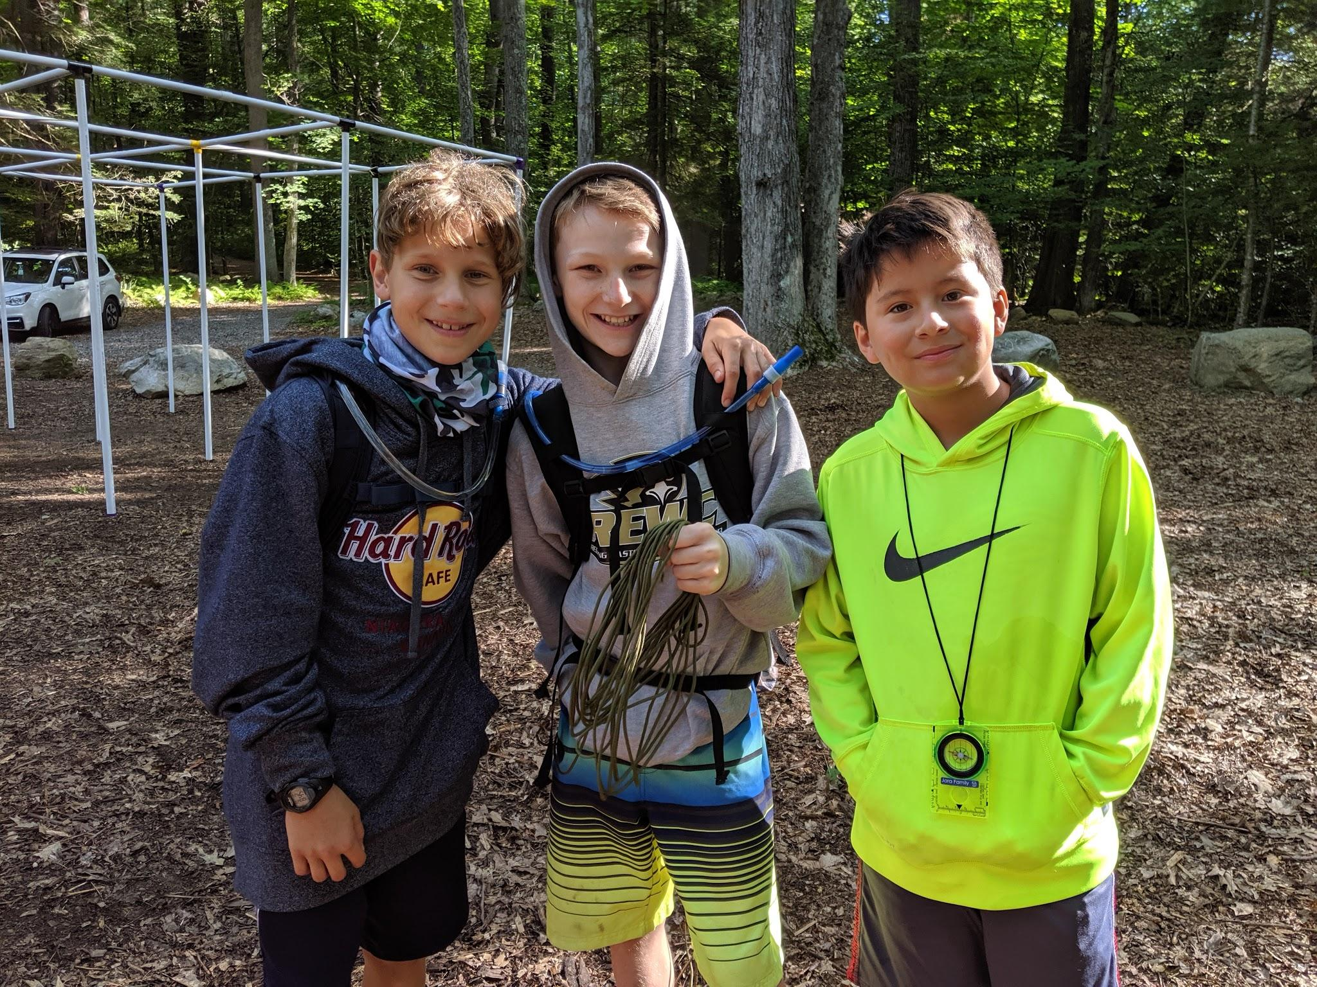
Summer Camp
One week sleepaway camp
Full of scouty goodness!
Shooting sports,
water front, campfires,
BMX biking, rock wall,
smelting iron, crafts,
mini zoo, star gazing,
sports, and more...

Slide 6
How do we do it?
Who’s in charge around here?

Slide 7
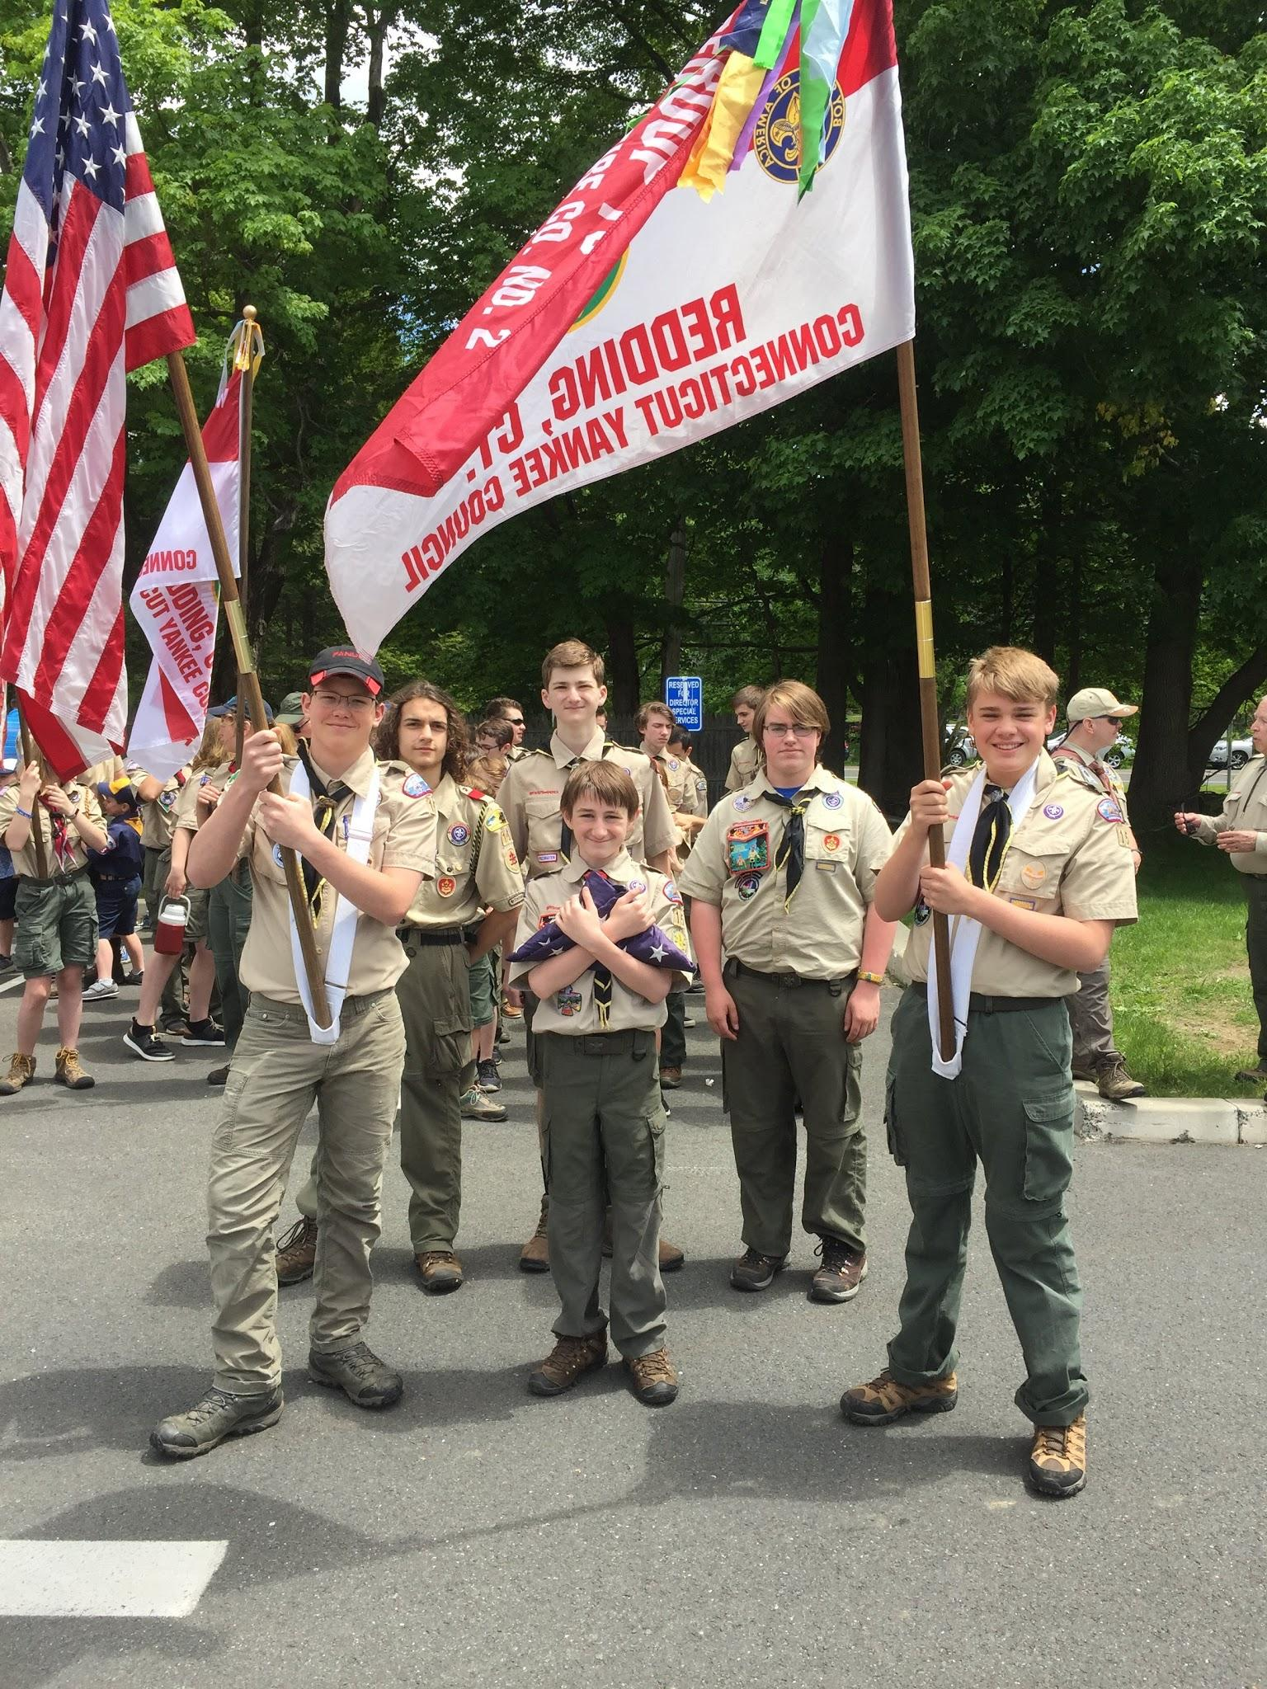
Troop Leadership
Scouts BSA is SCOUT-LED
Youth lead the troop
Youth decide what the troop does
Youth lead the activities
Youth teach each other
Monthly Patrol Leader Council
Adults provide needed support,
but are not in charge

Slide 8
Methods
Patrol Method
Advancement
Uniform
Leadership Development
Scouting Ideals
Outdoors
Adult Association
Personal Growth

Slide 9
Safety
Our #1 Job

Slide 10
Safety
Primary responsibility is safety
Youth Protection
No one-on-contact
Two deep Leadership
Certified trained leaders for all activities

Slide 11
FUNdraiser
The engine of the troop

Slide 12
Why do we do it?
What’s the point?

Slide 13
Aims
Character development
Citizenship training
Mental and Physical Fitness

Slide 14
Story

Slide 15
Testimonial

